Slide 1
Debuging WORKSHOP
Introduction & Preparation

Slide 2
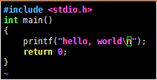
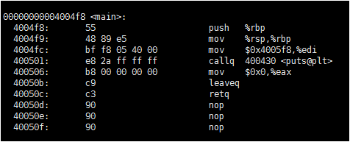
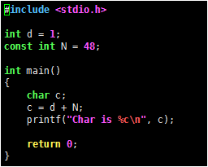
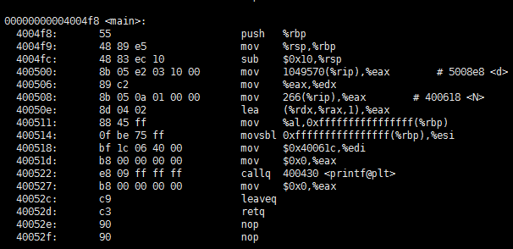
Hello world

Slide 3
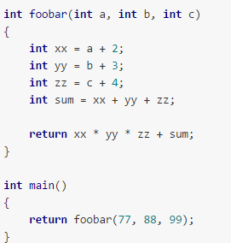
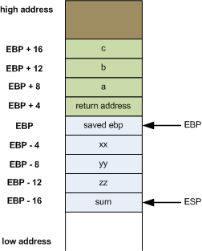
调用栈

Slide 4
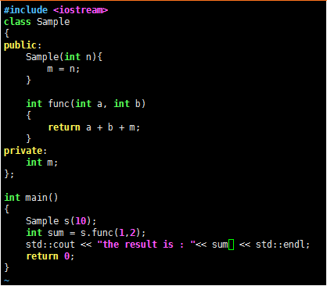
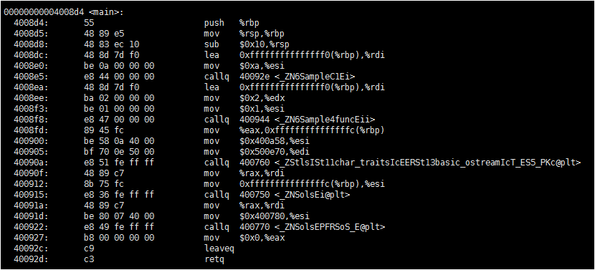
C++的反汇编

Slide 5
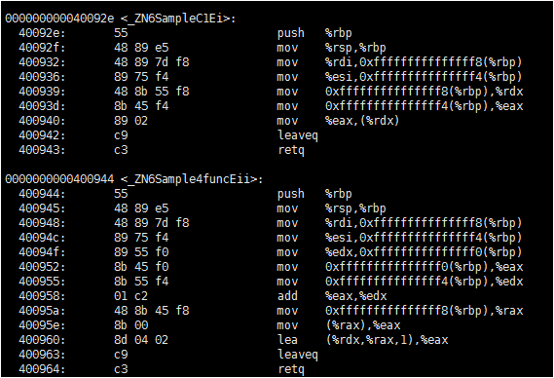
C++的反汇编

Slide 6
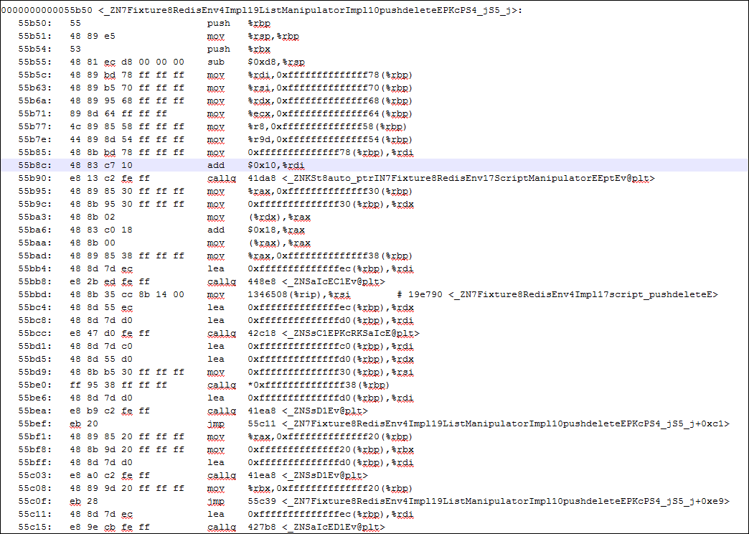
产品的反汇编

Slide 7
练习
破解crackme

Slide 8
Q & A

Slide 9
Thank You
For questions or suggestions:
Liu Jie
jieliu@thoughtworks.com

